Slide 1
715 Mohawk Squadron New Recruit Presentation

Slide 2
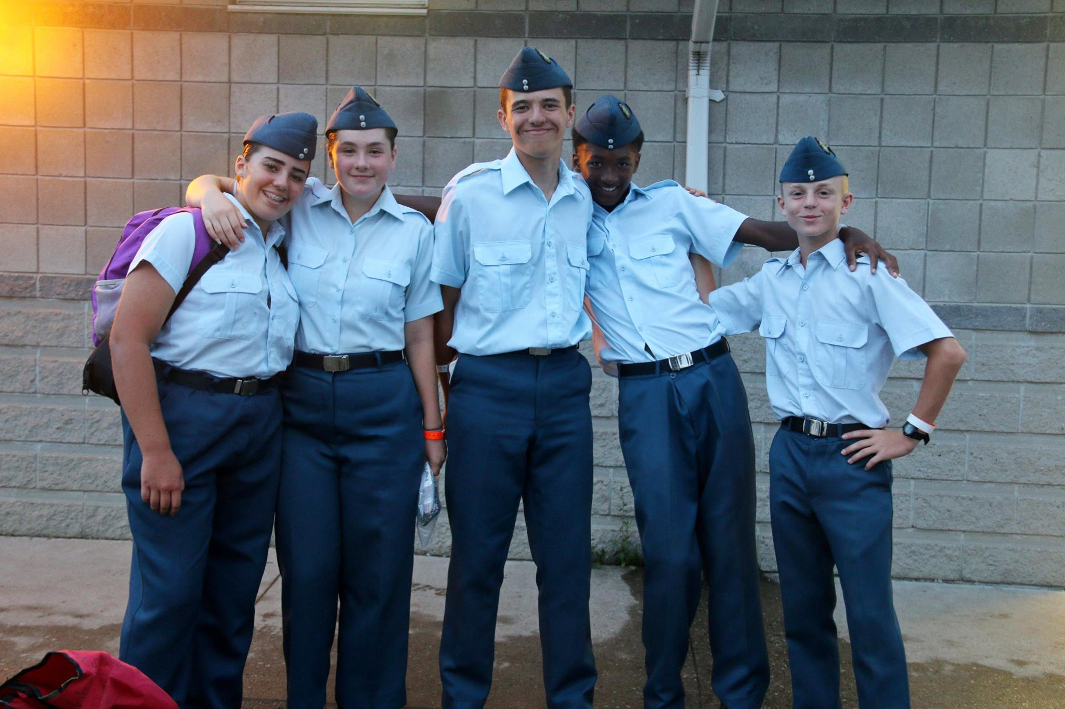
Outline
How much does it cost?
Who are the staff?
Weekly Training
Monthly Training
Summer Training
Awards and Promotions
Annual Ceremonial Review

Slide 3
How much does it cost?
Assessment Fee
Fee charged per cadet from the Ontario Provincial Committee (OPC)
Our Squadron Sponsoring Committee (SSC) subsidizes part of this cost
$40 per cadet per year
OPC Lottery Tickets
These tickets are a mandatory fundraiser to be sold by cadets and are used to fund various activities and programs
Each cadet and staff member are expected to sell 2 books of tickets
A deposit of $120 is paid upon registration for 2 books ($60 per book)
The money is recouped by the cadet and family when they sell the tickets

Slide 4
How much does it cost?

Slide 5
How much does it cost?
What does this cost get my cadet?
Although there is an annual registration fee so much of the program is at no cost to the cadet.
What is free?
Full Uniform (Until you get your uniform wear White collared shirt and dark pants)
Weekly Activities (3-4 days a week)
Weekend Camping
Summer Training
Flying Familiarization
Some Optional Trips (those that have a cost are always subsidized)

Slide 6
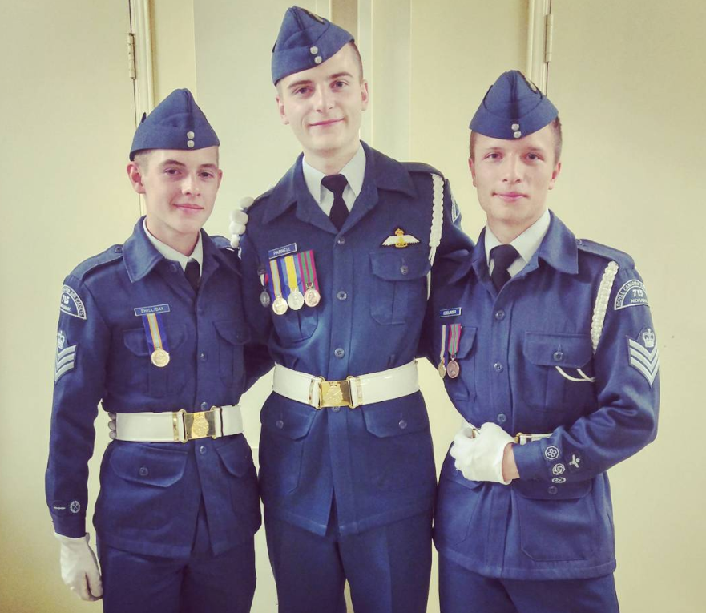
Who are the Staff:
This is a Cadet led Adult Managed Program.
What does that mean?
Senior cadets (ages 16-18) run most of the cadet programs
Adult staff provide supervision and ensure a safe and fun environment

Slide 7
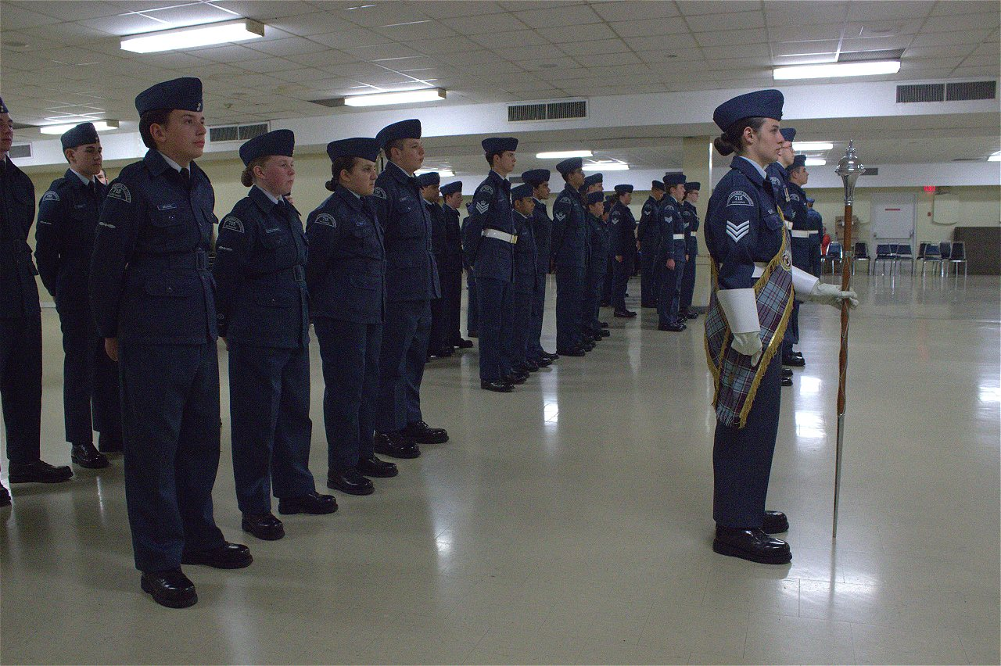
Who are the Staff:
Each Flight has a Flight Commander, this is a Cadet Leader.
Junior Cadets are encouraged to
attempt to contact them first
when they have questions or
are going to be absent.

Slide 8
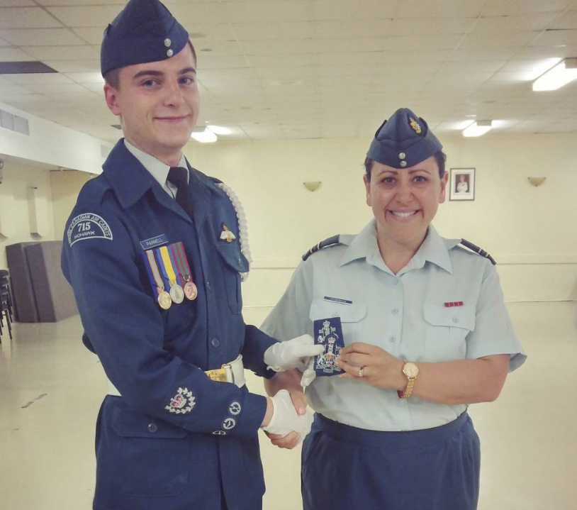
Who are the Staff:
Commanding Officer: Captain Ohanian-May

Slide 9
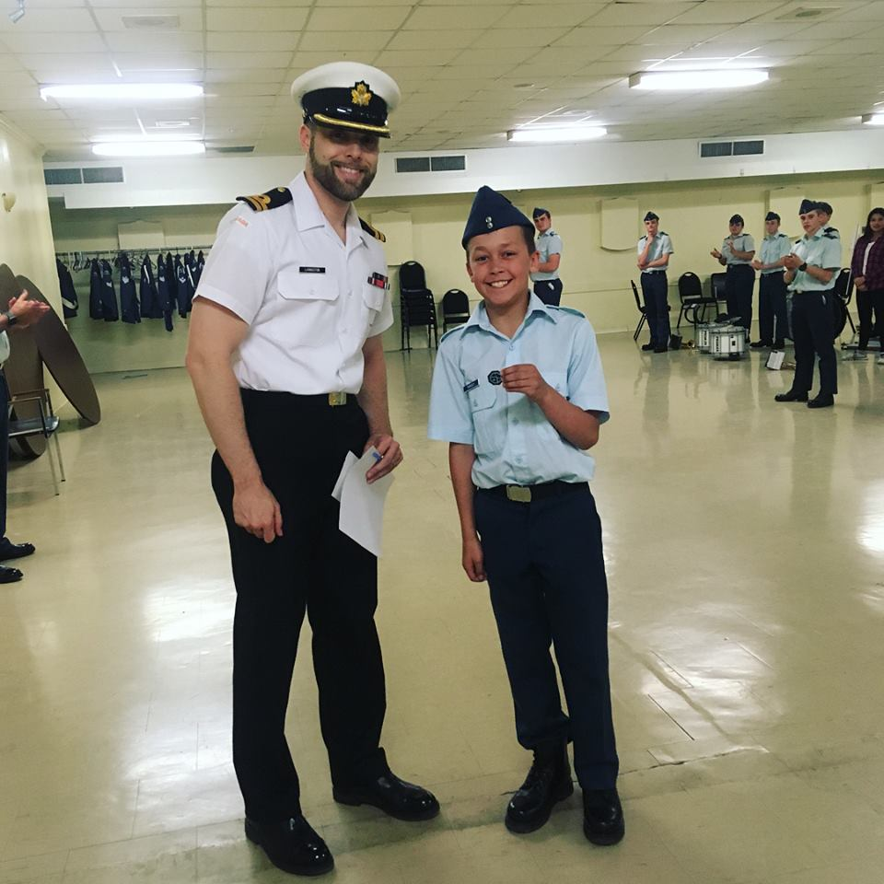
Who are the Staff:
Commanding Officer’s Representative:
Lieutenant (Navy) Livingston
Also:
Range Safety Officer

Slide 10
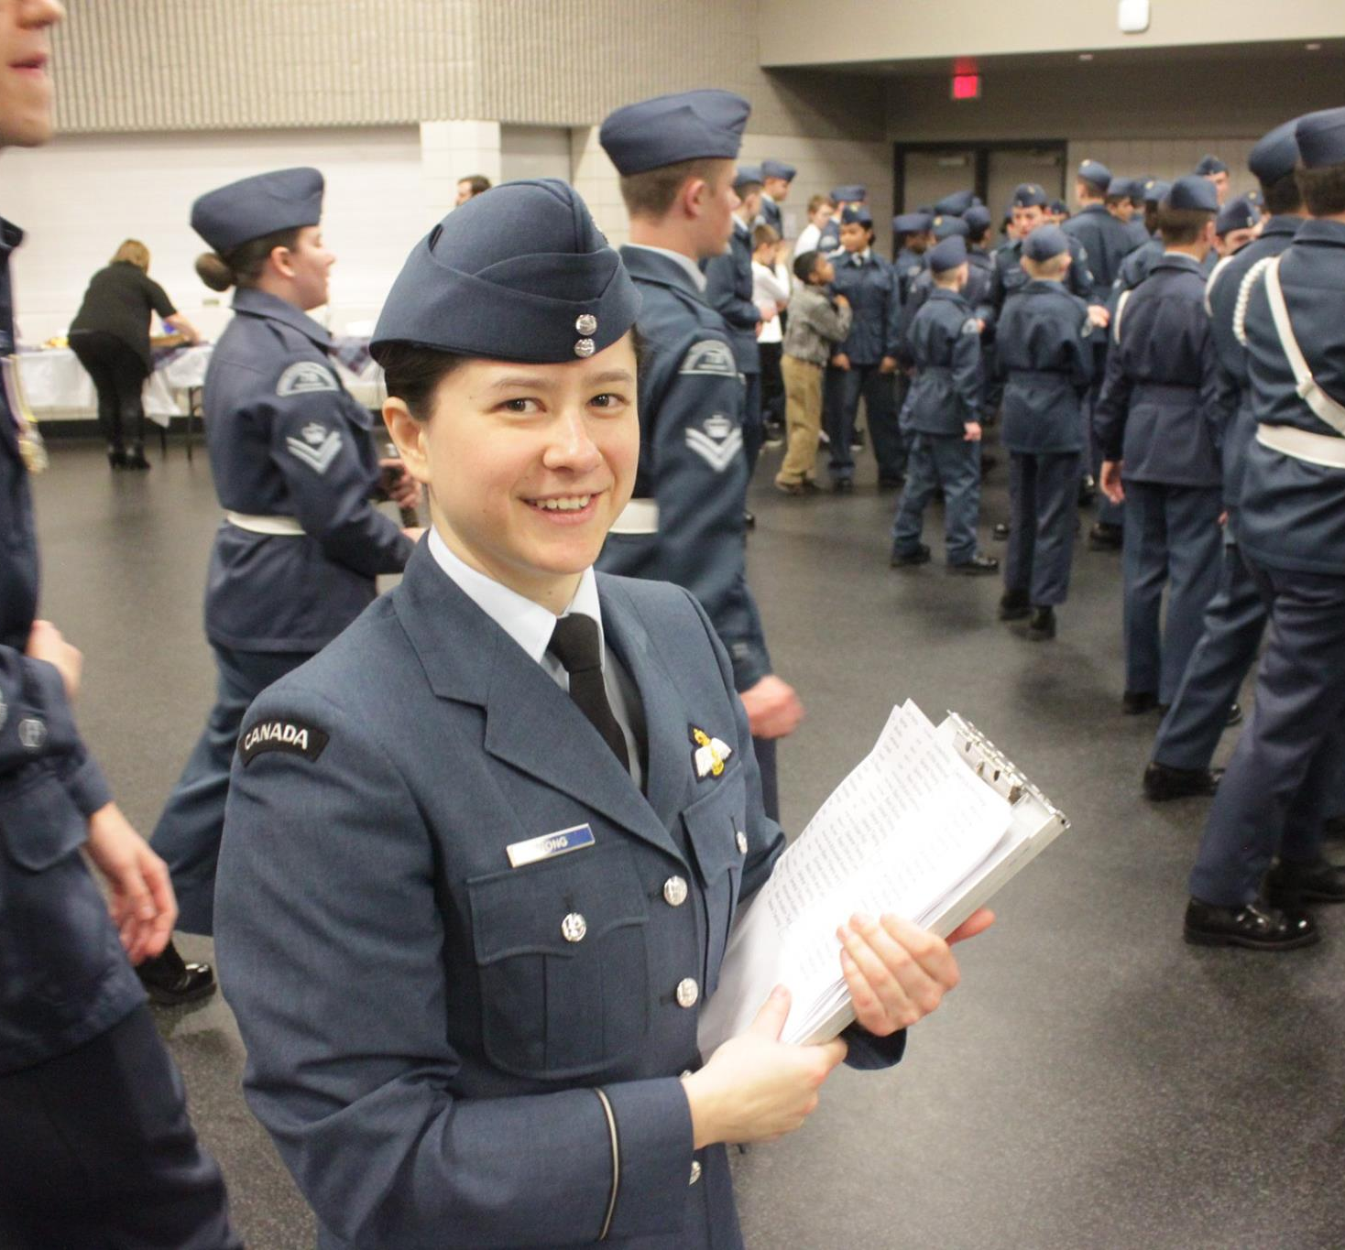
Who are the Staff:
Training Officer:
Officer Cadet E. Boychyn
Also:
Ground School Instructor
Duke of Ed Coordinator

Slide 11
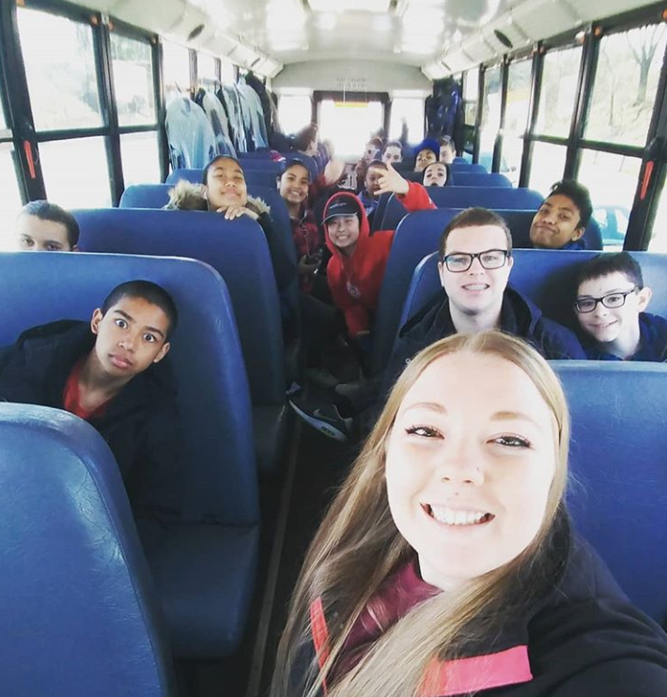
Who are the Staff:
Assistant Training Officer:
Civilian Instructor Macleod
Also:
Band Officer
Unit Public Affairs Representative (UPAR)

Slide 12
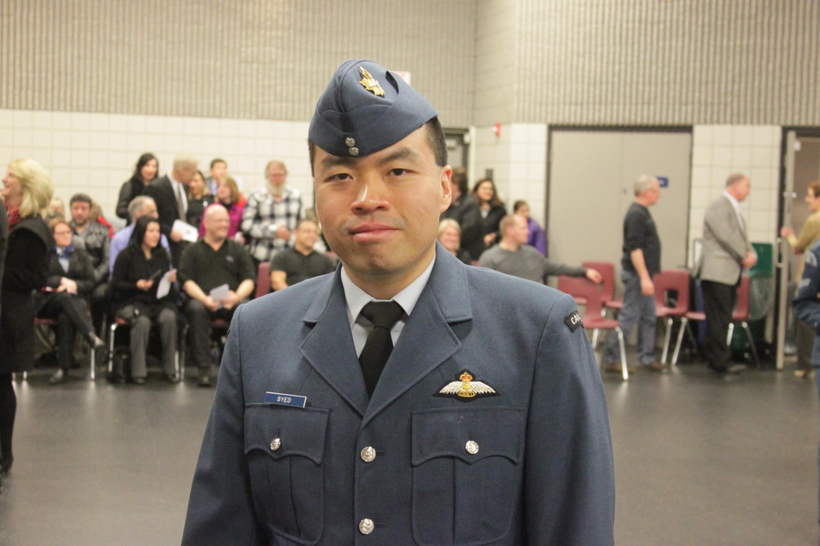
Who are the Staff:
Administration Officer:
Lieutenant Syed

Slide 13
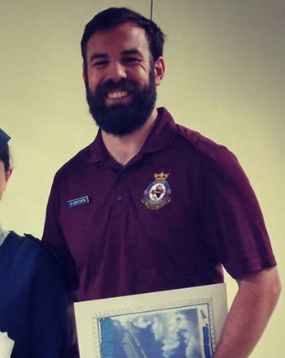
Who are the Staff:
Supply Officer:
Officer Cadet J. Boychyn
Also:
Ground School Instructor
Assistant Supply Officers:
CV Crocker

Slide 14
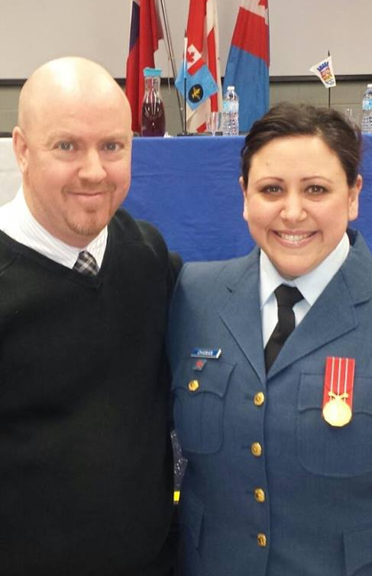
Who are the Staff:
Summer Training Officer:
Civilian Instructor May

Slide 15
Weekly Training
Monday | Tuesday | Wednesday | Thursday | Friday | Saturday | Sunday
Band 1800-2100 | Regular Training 1830-2130 | Range 1830-2030 Drill 1900-2100 | Effective Speaking 1800-2000 |  | Ground School 0830-1200
*Range and Drill on Wednesdays alternate weeks

Slide 16
Weekly Training
Regular Training:
Tuesday 1830-2130 (6:30pm-9:30pm)
Cadets learn various subjects in their Levels
Aviation and Aerospace, Leadership, Team Building, History
Levels 1-5 organizes cadets based on age and experience
*Cadets who join at the age of 14 or older may be eligible to move to higher level (please enquire with Training Officer)

Slide 17
In this class cadets are learning about appropriate clothing to wear on a Survival Training Exercise (Camping Weekend)

Slide 18
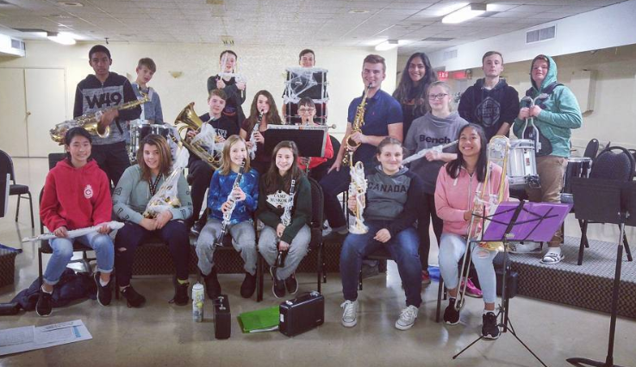
Weekly Training
Band:
Monday 1800-2100 (6:00pm-9:00pm)
No experience Required and No Instrument Required!
Our staff and cadets will provide an instrument and
instruction on how to play
*Instrument availability is limited
and not all instruments are available
at all times. Please see the Band Officer
or Drum Major if you are interested in
joining band.

Slide 19
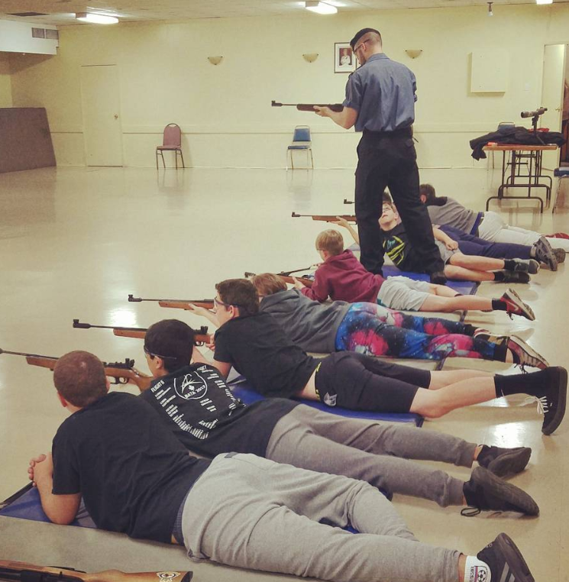
Weekly Training
Range:
Wednesday 1830-2030 (6:30pm-8:30pm) *Alternating weeks
Focus on proper use and safe handling of Firearms
Based on Olympic Style Competition
Use Daisy Air Rifle
Managed by Trained Range Safety Officer

Slide 20
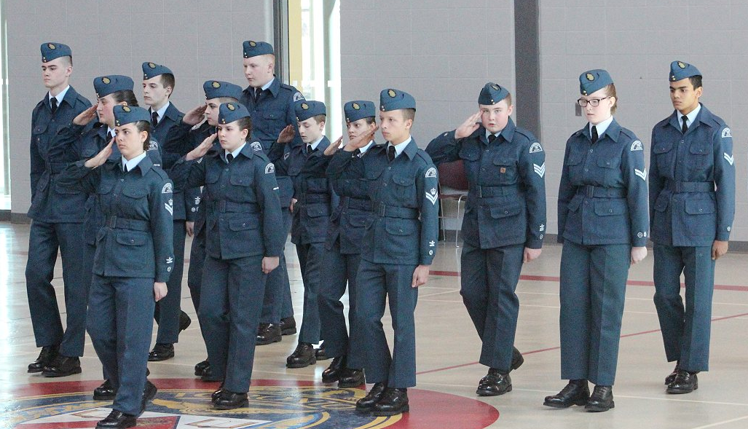
Weekly Training
Drill:
Wednesday 1900-2100 (7:00pm-9:00pm) *Alternating weeks
Cadet perform precision marching skills
Develop unique silent sequence
Complete with other Units from all over Ontario

Slide 21
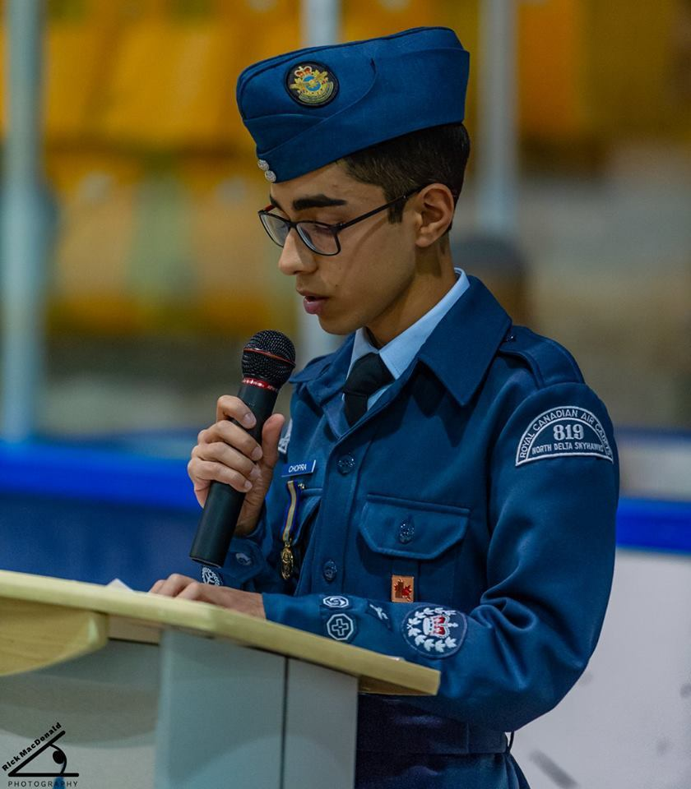
Weekly Training
Effective Speaking Team:
Thursdays 1800-2000 (6:00pm – 8:00pm
Cadets develop their effective speaking and debate skills
Opportunity to participate in effective speaking and debate competitions

Slide 22
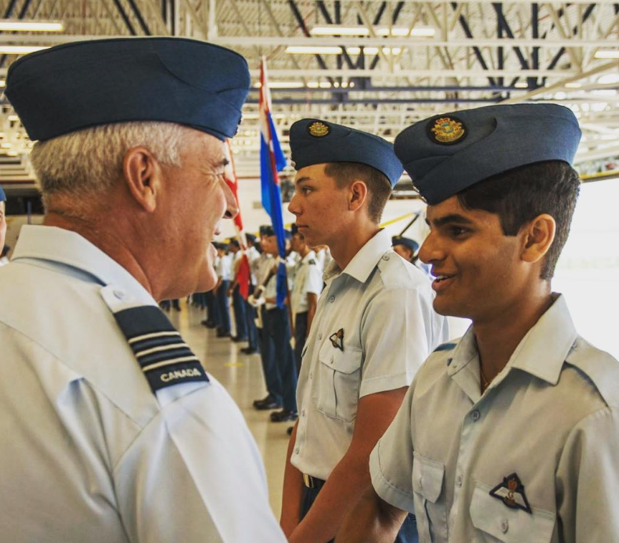
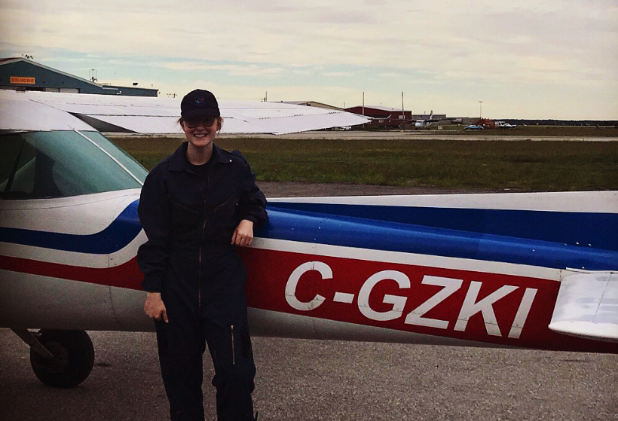
Weekly Training
Ground School:
Saturday 0830-1200 (8:30am-12:00pm)
All cadets have opportunity to obtain Scholarship to get Pilots License
Sqn runs Preparation course for Flying Scholarship application
All members invited but must be turning 16 to apply for Scholarship

Slide 23
Monthly Training
We normally run about one major weekend event per Month. Some of these are mandatory some are optional.
Weekend Camping
Fundraising
Community Service Events
Parades
Flying Familiarization
Field Trips/Fun Days

Slide 24
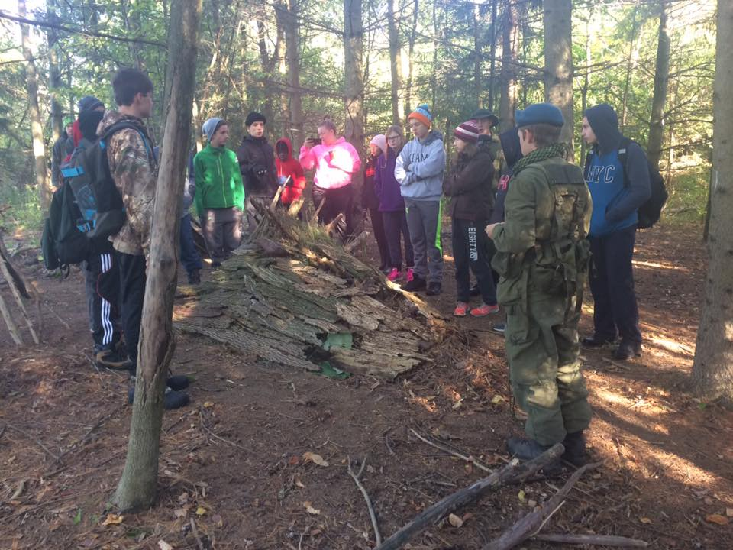
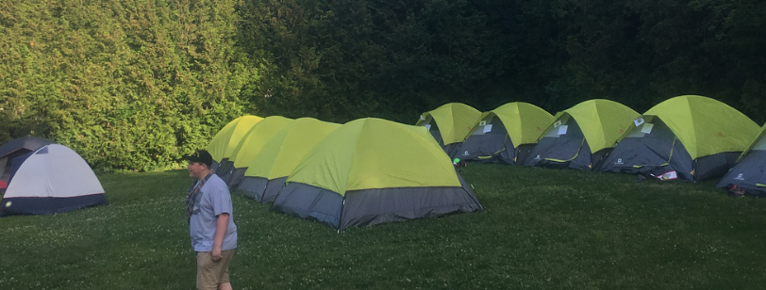
Monthly Training
Field Training Exercise (FTX):
Weekend Camping Trip
2-3 Times a year (Fall, Spring, Summer)
Mandatory to Complete Level Training

Slide 25
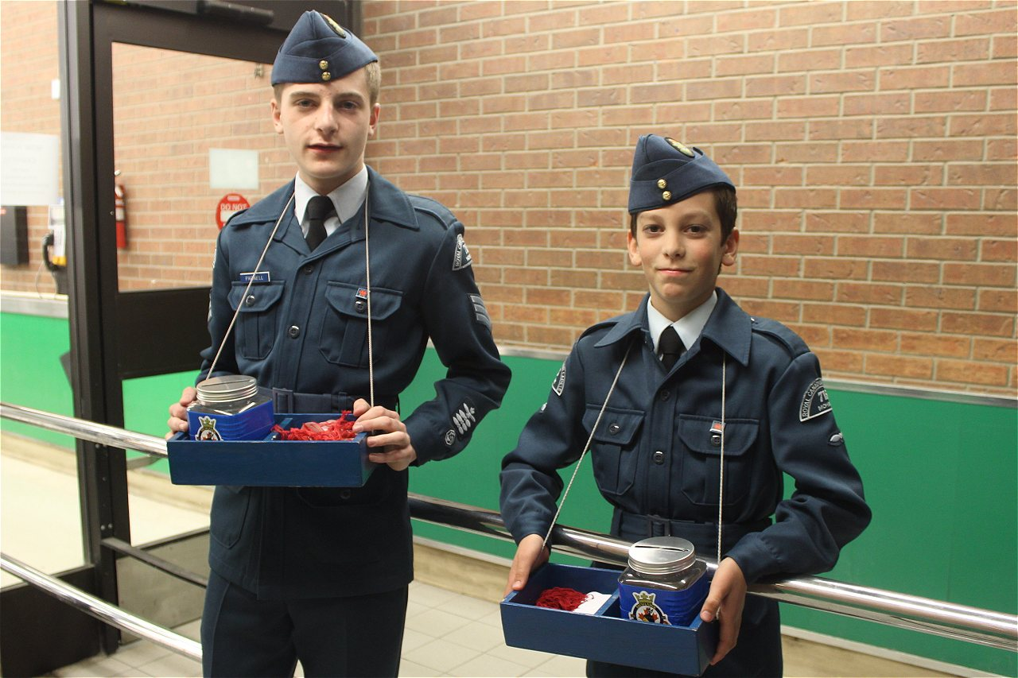
Monthly Training
Fundraising:
Tagging – Twice a Year Mandatory
Bingo – Every Sunday at Bingo Connection
Garage Sale – Twice a Year
Comedy Night - November

Slide 26
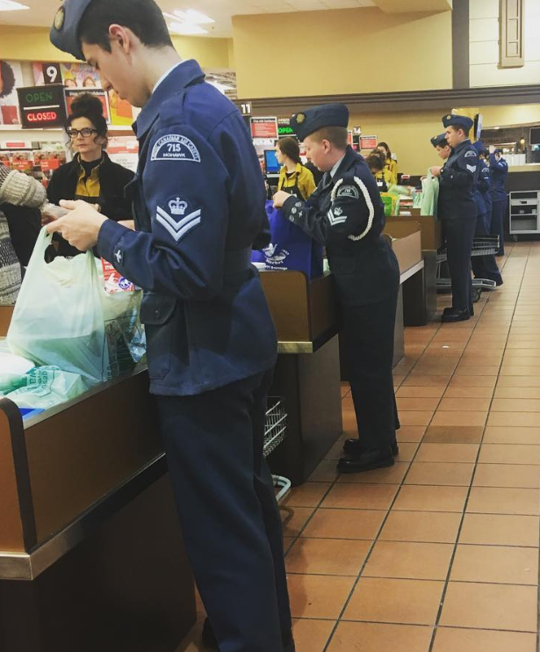
Monthly Training
Community Service:
Adopt a Road (Highway Clean Up) – Twice a Year
Community Races
Poppy Sales
Bagging

Slide 27
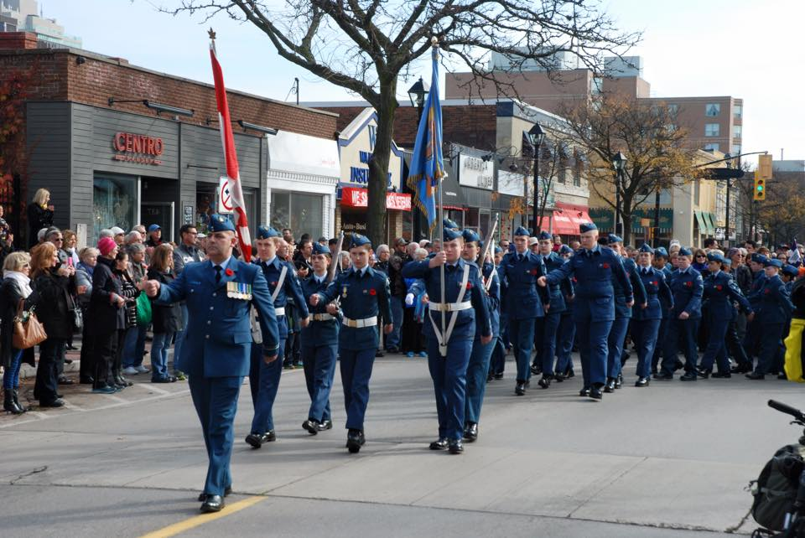
Monthly Training
Parades:
Remembrance Day Parade (Mandatory)
Santa Claus Parade
Vimy Anniversary Parade

Slide 28
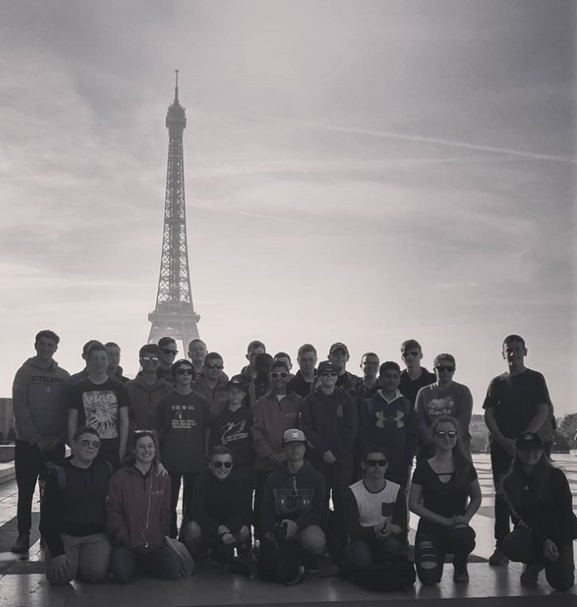
Monthly Training
Fun Trips:
Places We’ve Been
Wonderland
Quebec City
Vimy, France
Ottawa
Hamilton Warplane Museum
Trampoline Park
Bowling
And many more

Slide 29
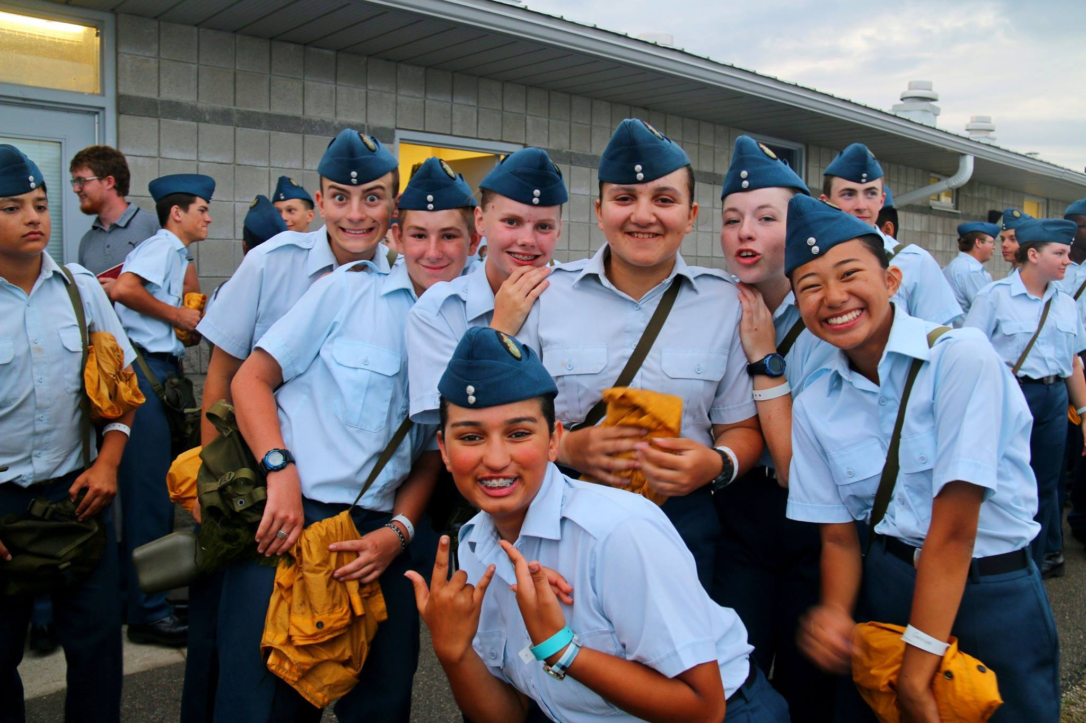
Summer Training
Not Mandatory, buy highly recommended
Courses range from 2-7 weeks
How much does it cost?
Actually you get paid $60 per
week!
Limited number of spots so not
everyone may go
Selection is based on
participation and CO’s
recommendation

Slide 30
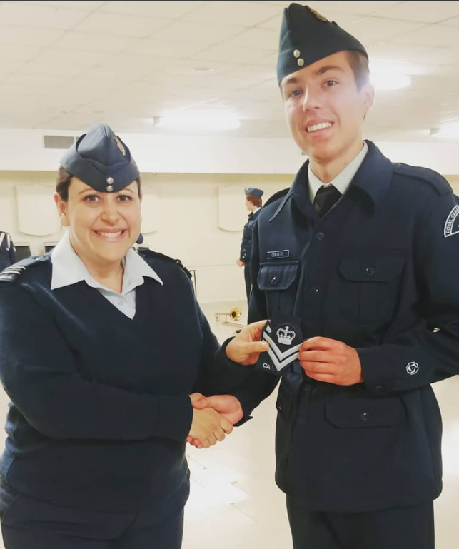
Awards and Promotions
Cadets can receive awards and promotions for their hard work.
These are not a right but a privilege earned for their hard work
Awards and Promotions are presented at our CO’s Parades that occur once a month (usually last Tuesday of every Month)

Slide 31
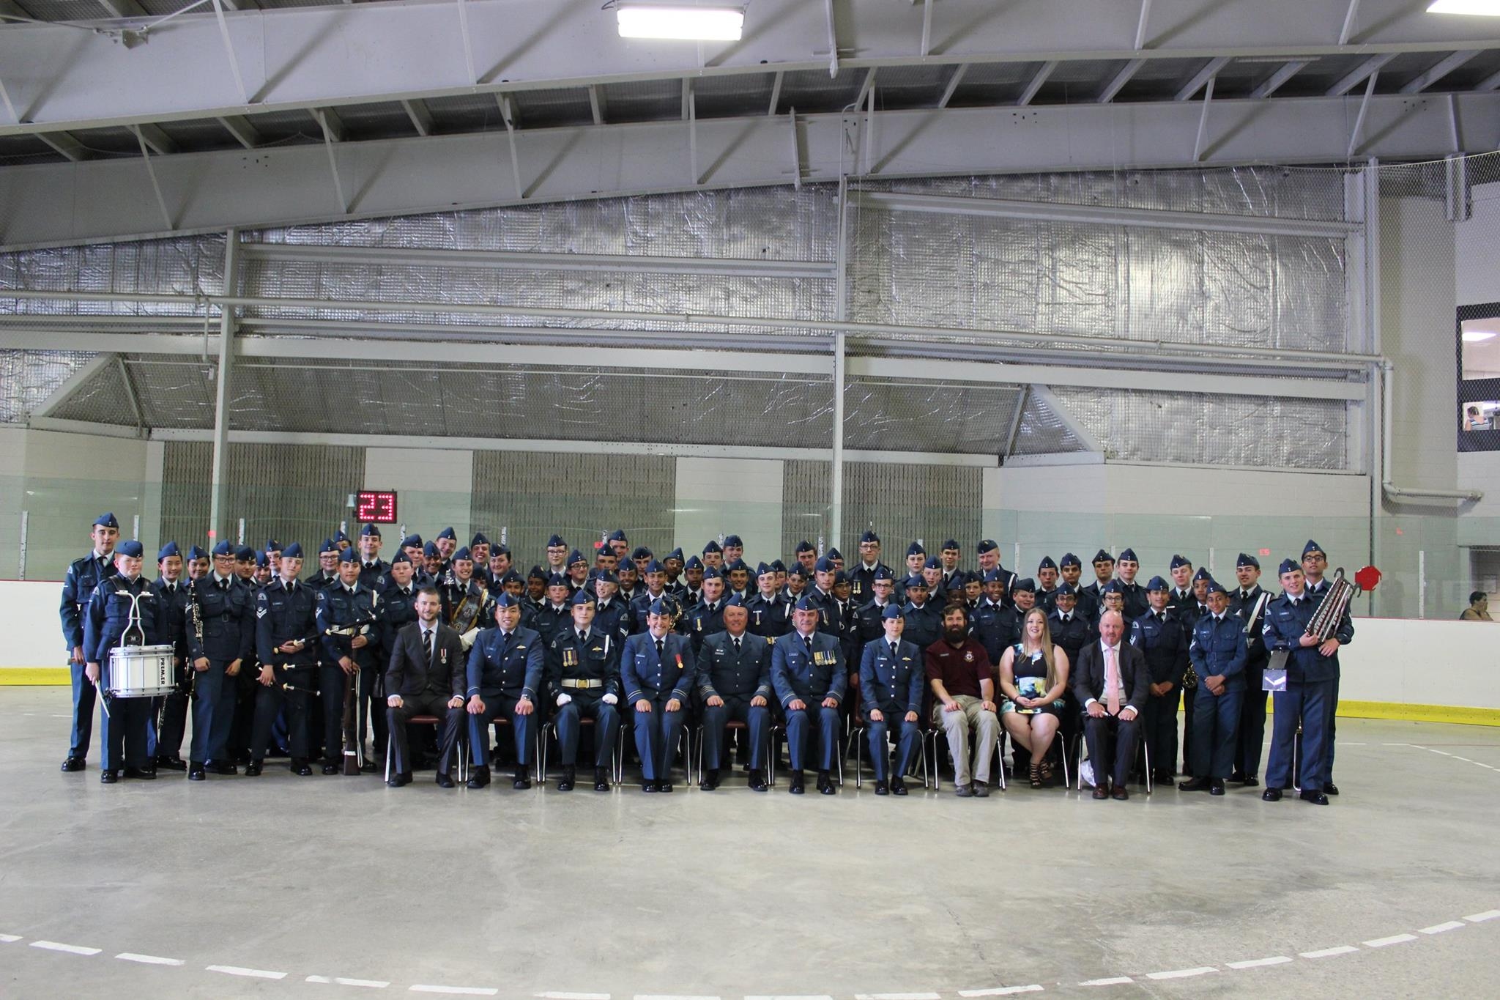
Annual Ceremonial Review
At the end of every training year cadets participate in a large parade to celebrate all their hard work
This is a Mandatory Event
Family and friends are invited and encouraged to attend
Annual Squadron Awards are presented this day

